Slide 1
PV fed LUO Converter Based Battery Management System
For Electric Vehicle Applications

Slide 2
CONTENTS
Abstract
Introduction
Literature Survey
Existing method
Proposed method
Implementation strategy
Software Implementation
Conclusion
Future scope
Reference

Slide 3
ABSTRACT
The growing demand for electric vehicles (EVs) as a sustainable and environmentally friendly mode of transportation has prompted the need for efficient battery management systems (BMS) to enhance the performance and reliability of EV power sources. In this project, grid-tied photovoltaic (PV)-fed Luo converter-based BMS for electric vehicle applications is proposed and implemented using MATLAB Simulink. In Existing system there is a drawback with Standalone system in which grid is unavailable. In this Proposed system ,the Luo converter is implemented which is known for its superior voltage conversion capabilities, is employed to efficiently manage the energy flow between the grid, the PV system, and the vehicle battery. This integration allows for bidirectional Flyback topology used to energy transfer from both the grid and the PV system to charge the EV battery and vice versa. The Proposed BMS includes control algorithms for optimizing battery state-of-charge (SOC) monitoring, and grid synchronization, ensuring seamless integration with the grid and efficient power transfer.

Slide 4
INTRODUCTION
.The Maximum power point tracking (MPPT) techniques which are used in PV systems to increase the PV array output power by tracking continuously the maximum power point depends on the panels of temperature and irradiance. In front of the existing model there may be some harmonics present.
This project is to implement the filter concept in our project to reduce the Harmonics effect so that we get pure AC source from solar inverters.The Luo converter, known for its high efficiency and ability to handle variable input voltages and currents, plays a pivotal role in this system. When coupled with grid-connected PV panels, it enables efficient energy harvesting and power transfer to the EV's battery pack.
The benefits of this system include reduced reliance on grid power, increased use of renewable energy sources, and improved energy efficiency, resulting in a more sustainable and cost-effective solution for electric vehicle users. Through simulation and analysis, the proposed grid-tied PV-fed Luo converter-based BMS demonstrates its potential to enhance the overall performance and reliability of electric vehicle application.

Slide 5
LITERATURE SURVEY

Slide 6
S. No | TITLE | AUTHOR & YEAR | THEME
1. | An Innovative Converterless Solar PV Control Strategy for a Grid Connected Hybrid PV/Wind/Fuel-Cell System Coupled With Battery Energy Storage. | Muhammad Majid Gulzar,Ayesha Iqbal Daud Sitbtain and Muhammed Khalid,13 February 2023, | The proposed work addresses the modeling, control, energy management and operation of hybrid grid connected system with wind-PV-Battery Energy Storage System (BESS) integrated with Fuel Cell (FC) and Electrolyzer. A hybrid PV-Wind-FC with electrolyzer consisting of BESS with the least number of control loops and converters has been proposed.
2. | Energy Management System for Hybrid Renewable Energy-Based Electric Vehicle Charging Station. | Ashish Kumar Karmakeri, MD Alamgir Hossain,23 March 2023. | The penetration of renewable energy sources (RESs) in the distribution system becomes a challenge for the reliable and safe operation of the existing power system. The sporadic characteristics of sustainable energy sources along with the random load variations greatly affect the power quality and stability of the

Slide 7
S.NO | TITLE | AUTHOR & YEAR | THEME
3. | A Power Management Scheme for Grid-connected PV Integrated with Hybrid Energy Storage System Control and Optimization of residential Photovoltaic Power Generation System With High Efficiency Isolated Bidirectional DC–DC Converter. | Anindya Bharatee, July 4,2022. | Currently, residential photovoltaic power generation system is increasingly used worldwide. In this paper, an optimized structure of residential photovoltaic (PV) power generation system with 1500V DC bus is proposed. It includes PV panels, a three-level boost converter, a high efficiency isolated bidirectional DC-DC converter, battery and three-phase five-level DC-AC converter that can work under islandingmode or grid-connected mode.
4. | Increasing Electric Vehicle Autonomy Using a Photovoltaic System Controlled by Particle Swarm Optimization. | HabibKraiem,Aymen flah,NaouiMohamed,Majed Alowaidi, May 20, 2021. | A photovoltaic-powered electric vehicle is a complex system that necessitates the use of a high-performance control algorithm. This paper aims to boost the performance of a photovoltaic system by employing a suitable algorithm to control the power interface. The main goal is to find an effective and optimal control law that will enable the photovoltaic generator (GPV) to generate the maximum amount of power possible.

Slide 8
S.NO | TITLE | AUTHOR & YEAR | THEME
5. | Control and Optimization of Residential Photovoltaic Power Generation system with High Efficiency Isolated Bidirectional DC-DC Converter. | Rui li, Fangyuvan shi August 31, 2019 | This paper introduces an energy management algorithm for a hybrid solar and biogas-based electric vehicle charging station (EVCS) that considers techno-economic and environmental factors. The proposed algorithm is designed for a 20-kW EVCS and uses a fuzzy inference system in MATLAB SIMULINK to manage power generation, EV power demand, charging periods, and existing charging rates to optimize real-time charging costs and renewable energy utilization.

Slide 9
EXISTING SYSTEM
The battery protection has been carried out from over flow and deep discharge of the battery by using battery management system (BMS). The Electric vehicle battery is fed power from a photovoltaic (PV) panel system through a power electronic converter interface with MPPT technique. The PV modules are arranged in series and parallel as per voltage and current rating, for which the specification .The PV system current IPV and voltage VPV is multiplied to obtain output power PPV and it is processed for MPPT. The Incremental Conductance (IC) method along with this is developed for MPPT process to generate duty cycle and it is supplied to boost converter. Further this duty cycle is adjusted accordingly to the rated required voltage to charge the battery.

Slide 10
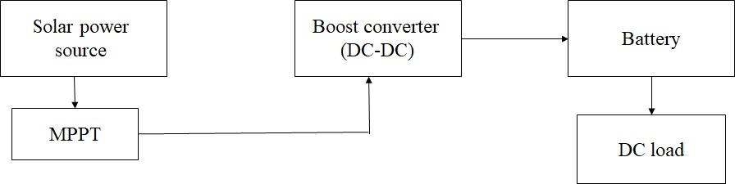
EXISTING BLOCK DIAGRAM

Slide 11
PROPOSED SYSTEM
The proposed system electric vehicle applications with solar based applications is implemented for power generation, bidirectional Luo converter is implemented for electric vehicle application, flyback topology is used to control the power from both the PV and the Grid.
The photovoltaic array is connected to the MPPT control. By using photovoltaic arrays the solar energy is converted into DC source. The MPPT control based on Hill climbing Algorithm is connected to Luo converter which is connected to battery through DC link controller. The Battery helps to store the DC and give back DC energy to the filter circuit.
The AC supply will be passed to the filter. It reduces the harmonics and gives supply to the battery when it is fully discharged. In this, harmonics is reduced by implementing the filter to get the AC source.

Slide 12
The power quality improvement using maximum power point tracking and harmonic reduction on grid connected photovoltaic systems is a process to get more power to reduce the losses. In this we are using the Hill climbing MPPT algorithm which gives more reliable output compared to the existing method.
Luo-Converters are a series of new DC-DC step-up power conversion circuits. These converters perform positive to positive DC-DC voltage increasing conversion.
When observing the maximum power point, the higher the voltage, the higher the peak power and the higher the charging efficiency.
The Battery is charged and discharged according to the performance of the converters and grid.
The AC Grid acts as a source which is connected to the load via DC link voltage.

Slide 13
PROPOSED BLOCK DIAGRAM
PV voltage
LUO Converter
Voltage source inverter
Transformer
Battery
Flyback converter
Grid
EV

Slide 14
IMPLEMENTATION STRATEGY
Design of Grid tied solar panel using Luo converter for battery management system to monitor SOC(State Of Charge) and output voltage and current of the battery.
To design a customized system based on the size and capacity requirements of the EV charging infrastructure.
The grid-tied inverters and safety devices are used.
Voltage source inverter is connected with ac load and dc load on this system.
Bidirectional Flyback Topology is implemented for improving the battery performance.

Slide 15
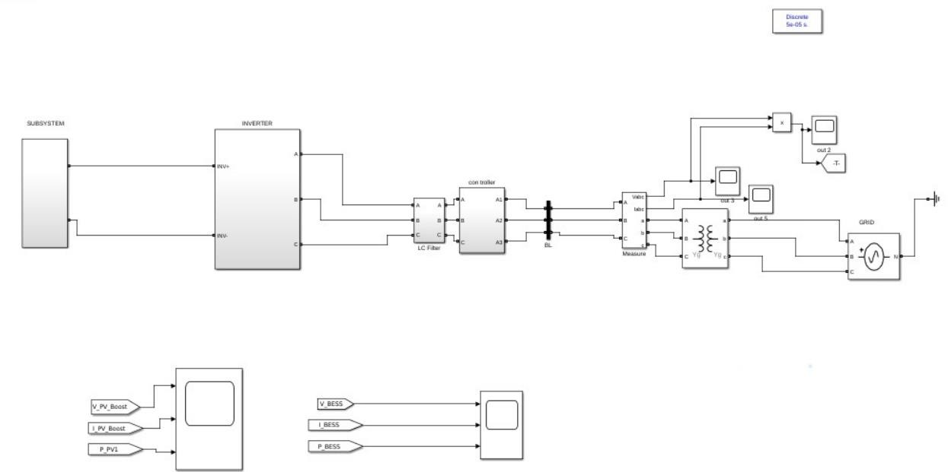
SOFTWARE IMPLEMENTATION
PV Module with MPPT based algorithm

Slide 16
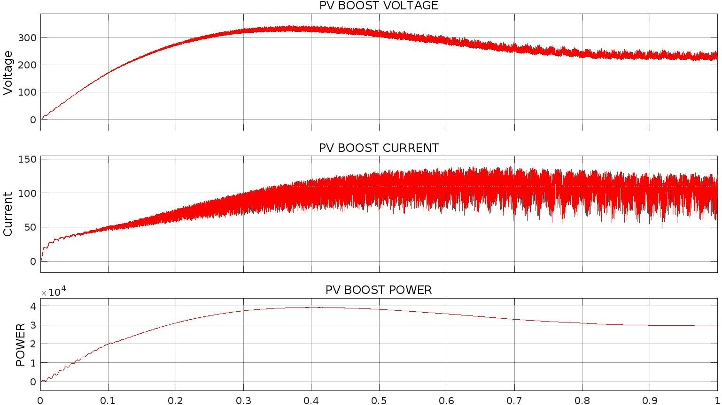
OUTPUT WAVEFORMS
Voltage and current characteristics of solar panel

Slide 17
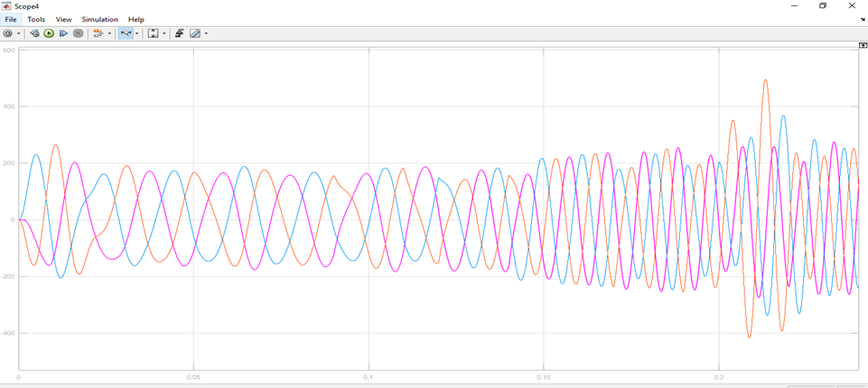
Output voltage of inverter

Slide 18
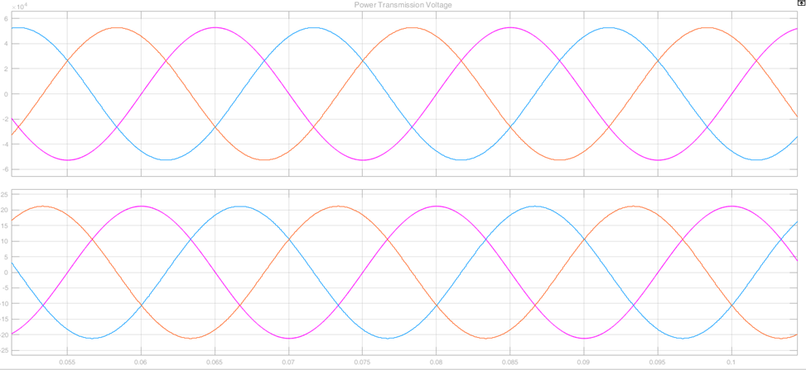
Grid voltage and current

Slide 19
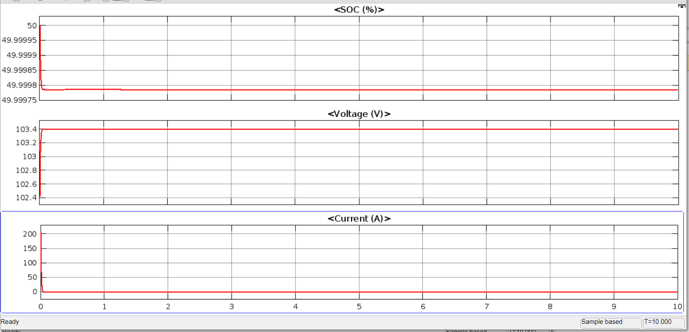
Battery SOC, voltage and current

Slide 20
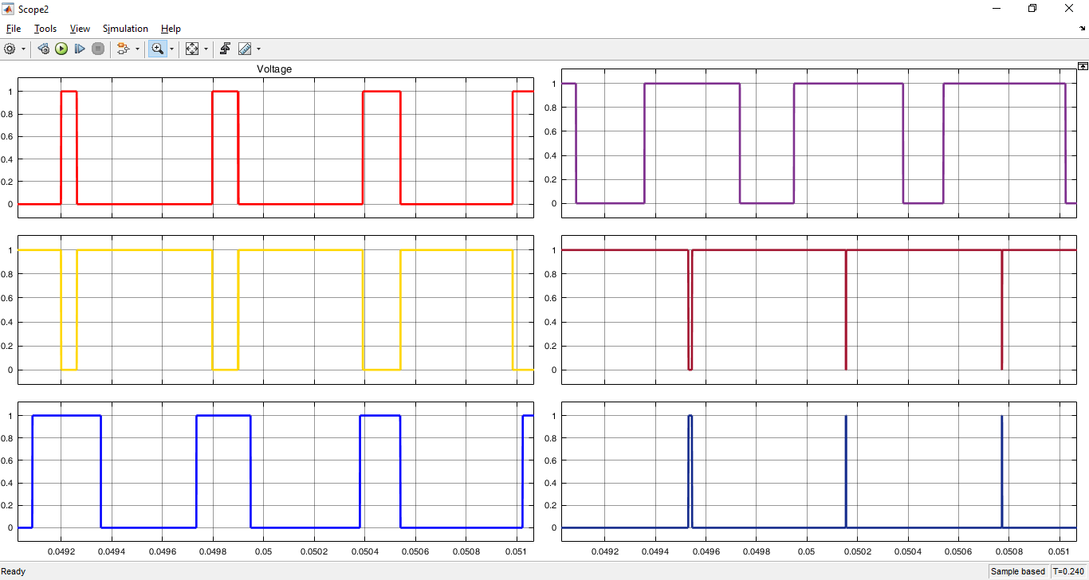
PWM Generation

Slide 21
REFERENCE
[1] Khan, S., Ahmad, A., Ahmad, F., Shafaati Shemami, M., Saad Alam, M., & Khateeb, S. (2023). A comprehensive review on solar powered electric vehicle charging system. Smart Science, 6(1), 54-79.
[2] M. Amir, A. K. Prajapati, and S. S. Refaat, ‘‘Dynamic performance evaluation of grid-connected hybrid renewable energy-based power generation for stability and power quality enhancement in smart grid,’’ Frontiers Energy Res., vol. 10, p. 222, Mar. 2022
[3] A. S. M. M. Hasan, M. A. Kabir, M. T. Hoq, M. T. Johansson, and P. Thollander, ‘‘Drivers and barriers to the implementation of biogas technologies in Bangladesh,’’ Biofuels, vol. 13, no. 5, pp. 643–655, May 2022.
[4] M. M. Gulzar, M. Iqbal, S. Shahzad, H. A. Muqeet, M. Shahzad, and M. M. Hussain, ‘‘Load frequency control (LFC) strategies in renewable energy-based hybrid power systems: A review,’’ Energies, vol. 15, no. 10, p. 3488, May 2022.
[5] M. Maaruf, K. Khan, and M. Khalid, ‘‘Robust control for optimized islanded and grid-connected operation of solar/wind/battery hybrid energy,’’ Sustainability, vol. 14, no. 9, p. 5673, May 2022.
[6] Y. Alhumaid, K. Khan, F. Alismail, and M. Khalid, ‘‘Multi-input nonlinear programming based deterministic optimization framework for evaluating microgrids with optimal renewable-storage energy mix,’’ Sustainability, vol. 13, no. 11, p. 5878, May 2021.

Slide 22


